Slide 1
Jack Linden Dass 112721214006
Final Project
3/21/2024 Annual Review

Slide 2

Hotel Booking analysis
3/21/2024 Annual Review

Slide 3


AGENDA
Introduction
Codes (Input)
Output
Conclusion
3/21/2024 Annual Review

Slide 4

PROBLEM STATEMENT
Have you ever wondered when the best time of year to book a hotel room is? Or the optimal length of stay in order to get the best daily rate? What if you wanted to predict whether or not a hotel was likely to receive a disproportionately high number of special requests? This hotel booking dataset can help you explore those questions! This data set contains booking information for a city hotel and a resort hotel, and includes information such as when the booking was made, length of stay, the number of adults, children, and/or babies, and the number of available parking spaces, among other things. All personally identifying information has been removed from the data. Explore and analyse the data to discover important factors that govern the bookings.
3/21/2024 Annual Review

Slide 5

PROJECT OVERVIEW
1.Data collection
Description of the data sources used (e.g., CSV files, databases, APIs).
Explanation of the data variables and their significance.
Discussion on data preprocessing steps (cleaning, handling missing values, data normalization, etc.).
Exploratory Data Analysis (EDA):
Statistical summary of the dataset.
Visualizations to understand patterns and trends in hotel bookings, such as:
Distribution of bookings over time (seasonality, trends).
Types of bookings (direct vs. through agents).
Distribution of bookings by geographic location.
Customer demographics (age, gender, nationality).
3/21/2024 Annual Review

Slide 6

WHO ARE THE END USERS?
Every family can be used to book hotel for their trips and other family trips and business trips
3/21/2024 Annual Review

Slide 7

YOUR SOLUTION AND ITS VALUE PROPOSITION
Problem Statement:
The hospitality industry faces challenges in optimizing revenue, managing bookings effectively, and enhancing customer satisfaction. Analyzing hotel booking data can provide valuable insights to address these challenges.
Our Solution:
We offer a comprehensive hotel booking analysis platform that leverages advanced data analytics techniques to provide actionable insights for hotel management and marketing teams.
3/21/2024 Annual Review

Slide 8

THE WOW IN YOUR SOLUTION
Here it has been separated by sores for each users to gain the average of liked consumers in the population
Predictive Personalization:
Our solution goes beyond traditional analytics by offering predictive personalization. By analyzing historical booking data and customer behaviors, we predict individual preferences and tailor recommendations, offers, and experiences to each guest, creating memorable and personalized stays that exceed expectations.
Dynamic Pricing Optimization:
We revolutionize revenue management with dynamic pricing optimization. Our platform continuously analyzes market demand, competitor pricing, and customer trends in real-time to dynamically adjust room rates, maximizing revenue without compromising occupancy levels or guest satisfaction.
AI-Driven Virtual Concierge:
Experience the future of hospitality with our AI-driven virtual concierge. Seamlessly integrated into our platform, this intelligent assistant anticipates guest needs, provides personalized recommendations, and facilitates instant bookings, enhancing convenience and delivering exceptional service 24/7.
3/21/2024 Annual Review
8

Slide 9
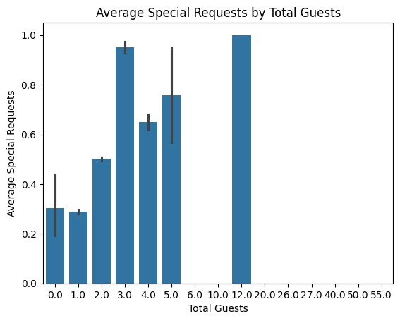
RESULTS
3/21/2024 Annual Review
9

